Slide 1

Reinforcement learning
Teaching a machine to learn though experience

Slide 2
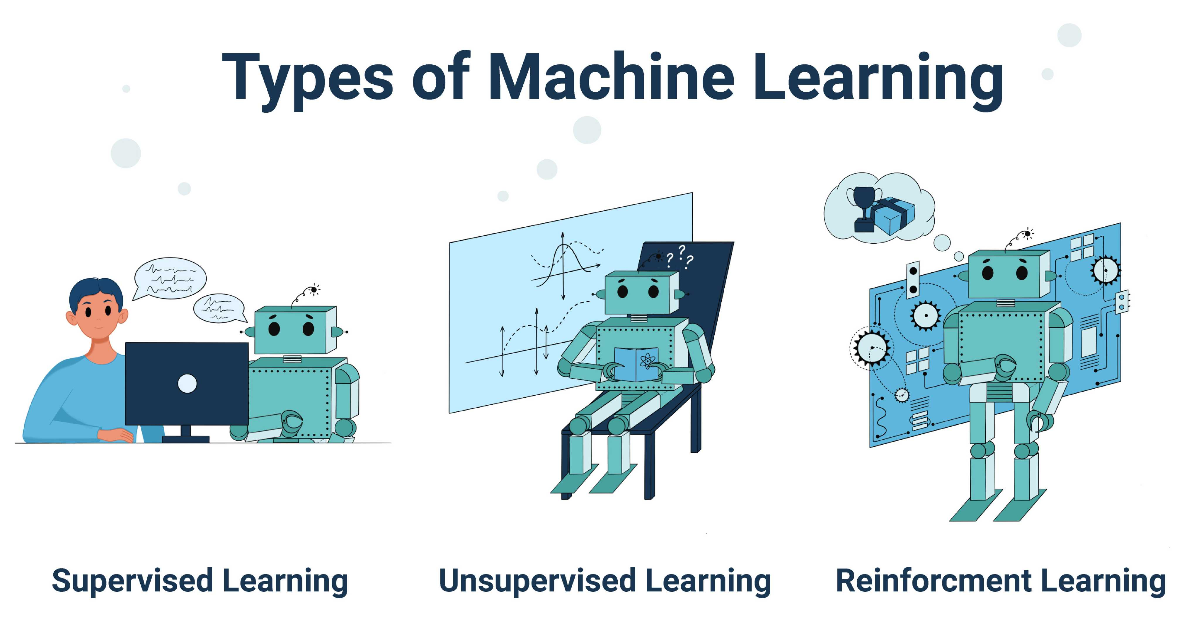
Machine learning

Slide 3
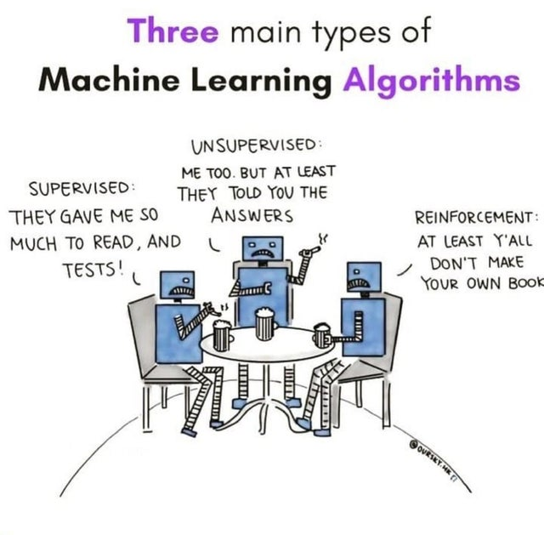

Slide 4
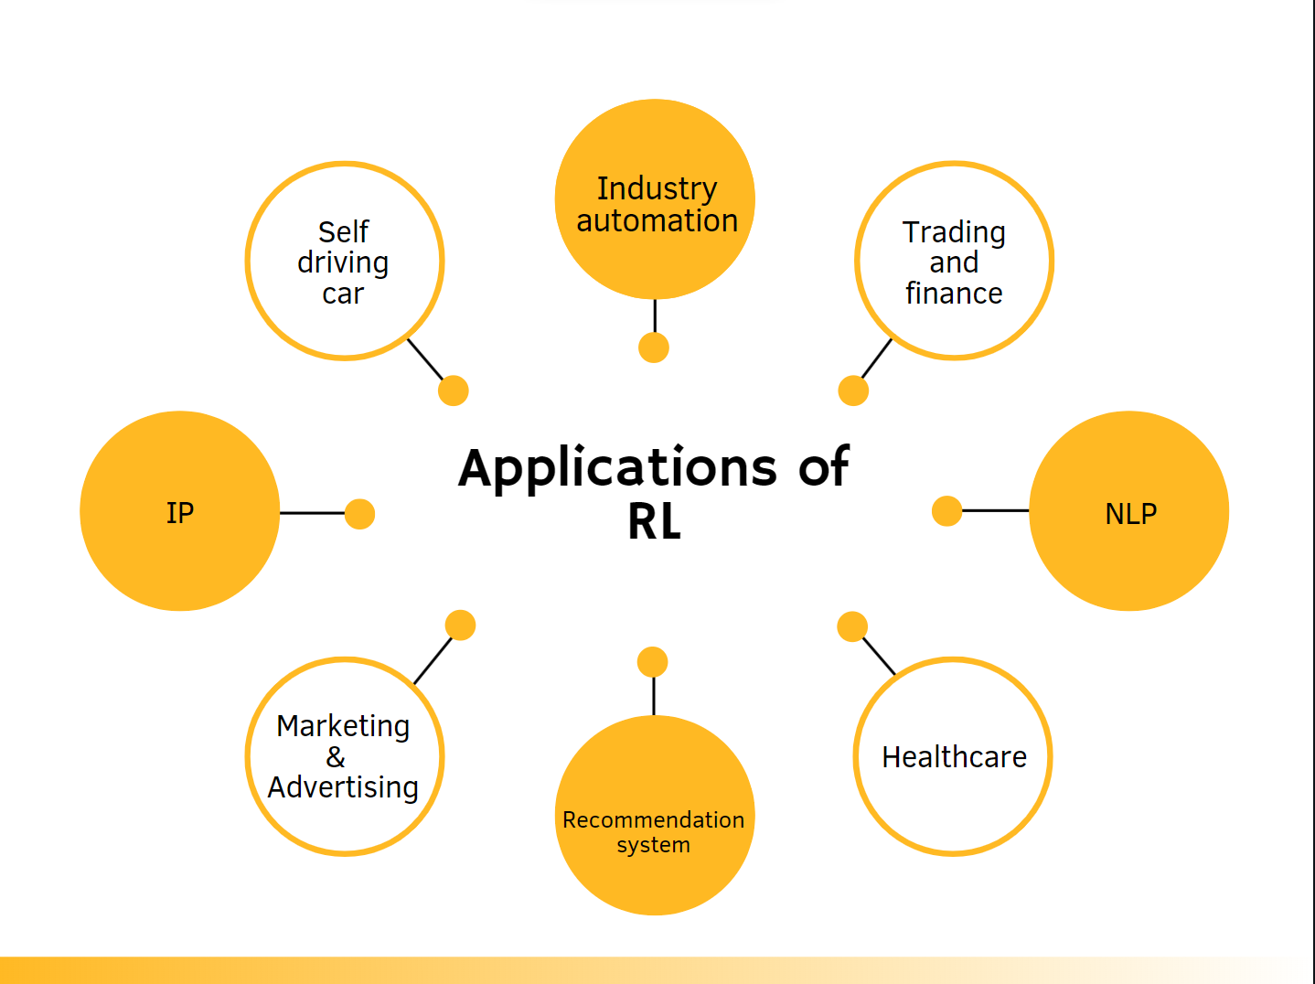

Slide 5
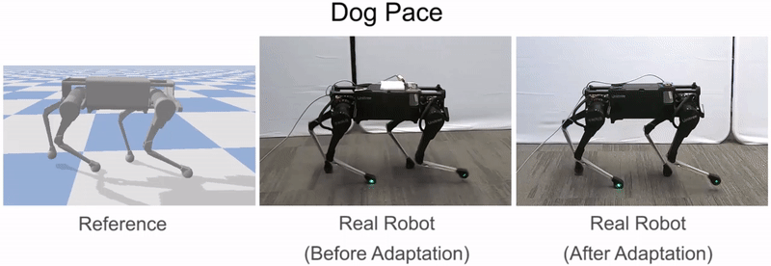
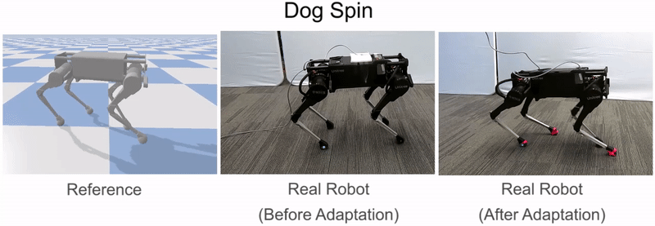

Slide 6
principle
Computational approach to learning from interaction.
Reinforcement learning, is much more focused on goal-directed learning from interaction than are other approaches to machine learning.
Reinforcement learning is learning what to do - how to map situations to actions - so as to maximize a numerical reward signal.

Slide 7
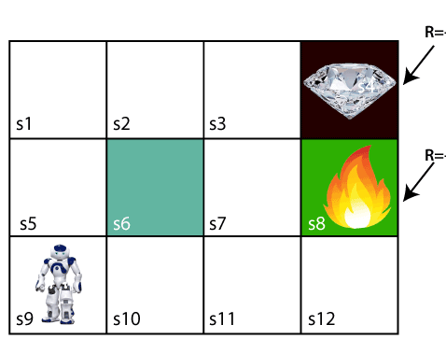
Trial and error and delayed reward
2
-1

Slide 8
Terms used
Agent: An entity that can perceive/explore the environment and act upon it.
Environment: A situation in which an agent is present or surrounded by. In RL, we assume the stochastic environment, which means it is random in nature.
Action: Actions are the moves taken by an agent within the environment.
State: State is a situation returned by the environment after each action taken by the agent.
Reward: A feedback returned to the agent from the environment to evaluate the action of the agent.
Policy: Policy is a strategy applied by the agent for the next action based on the current state.

Slide 9
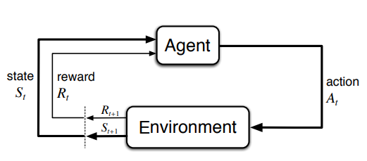
process

Slide 10
Agent and environment
In Reinforcement learning, the agent is one who takes decisions based on the rewards and punishments.
Environment is the Agent’s world in which it lives and interacts.
The agent can interact with the environment by performing some action but cannot influence the rules or dynamics of the environment by those actions.
Environment can be categorized in various ways

Slide 11
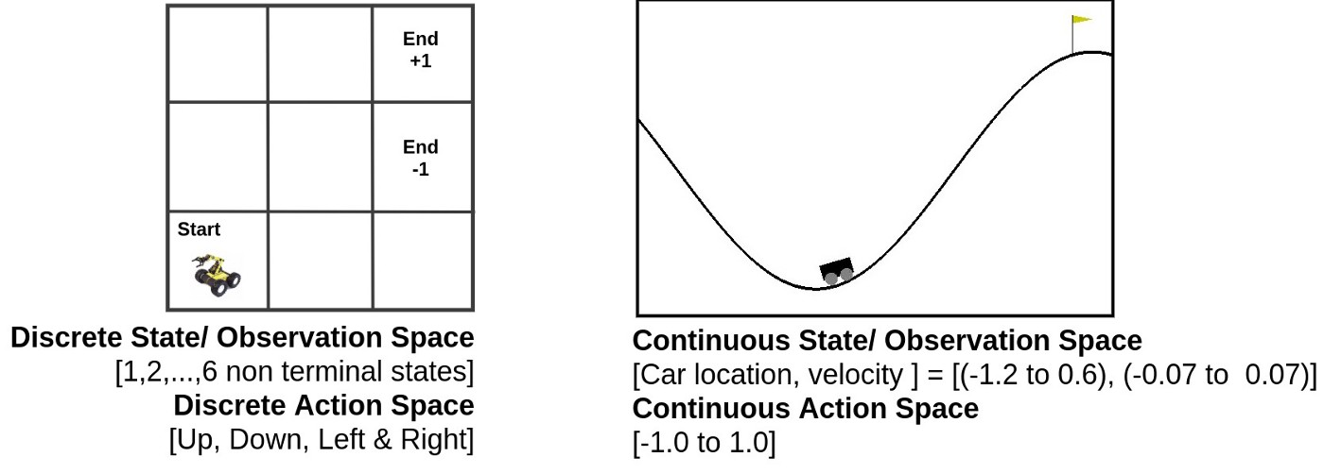
Environment- classification
Discrete
continuous
In discrete action space, all the actions are discrete in nature.
In continuous action space, the actions are continuous in nature.

Slide 12
Environment- classification
deterministic
stochastic
In a deterministic environment, the next state of the environment can always be determined based on the current state and the agent’s action.
In a stochastic reinforcement learning environment, we cannot always determine the next state of the environment from the current state by performing a certain action.

Slide 13
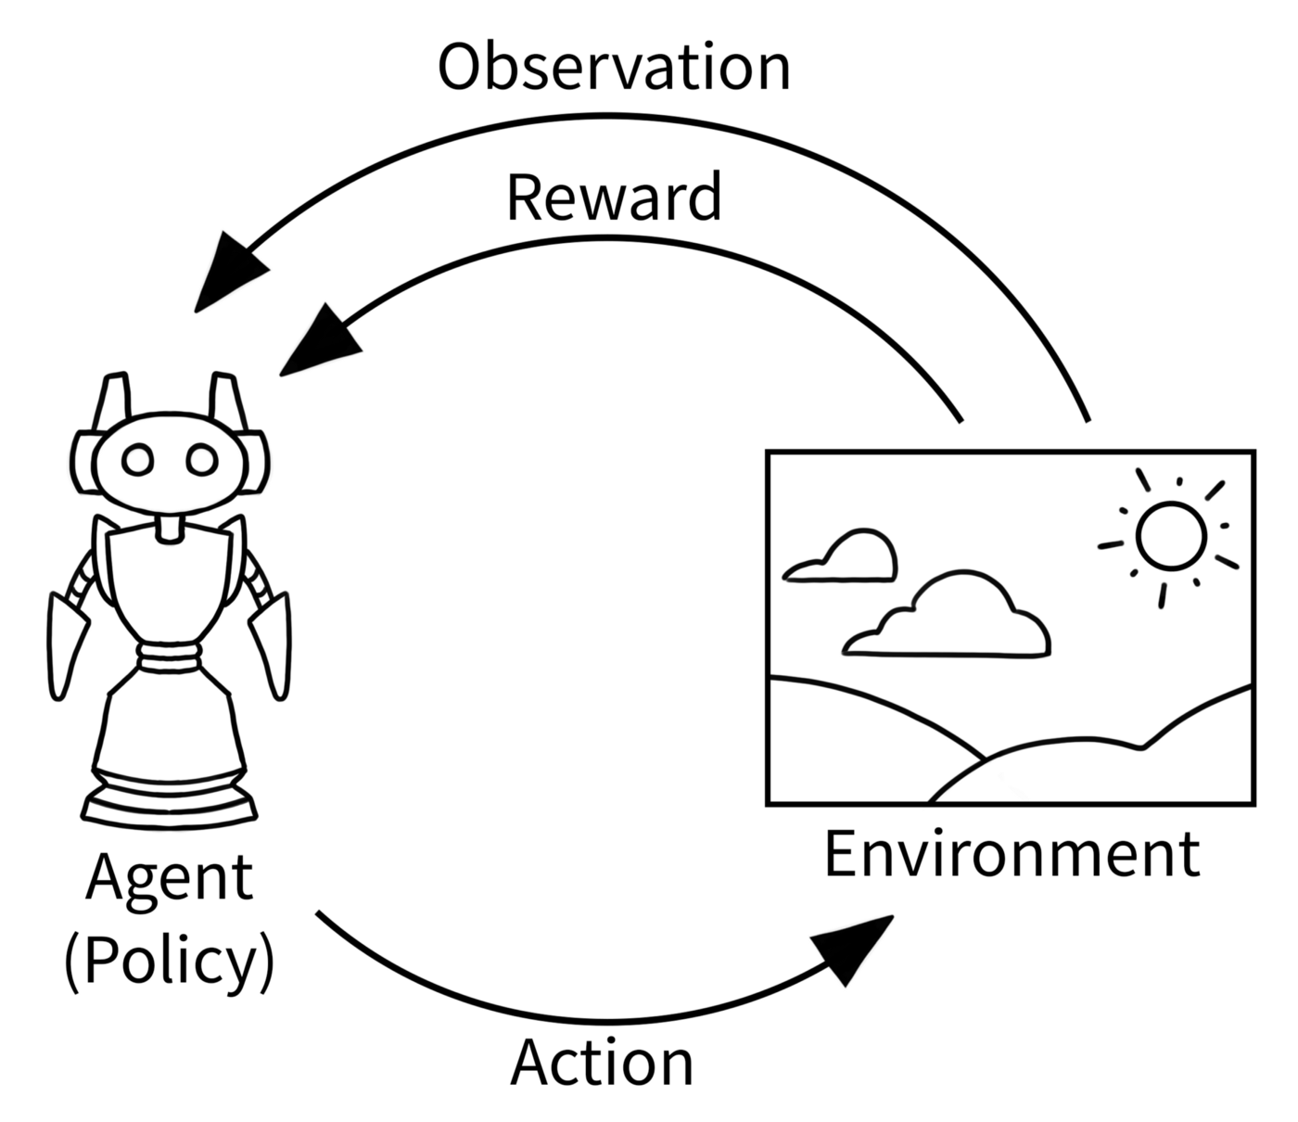
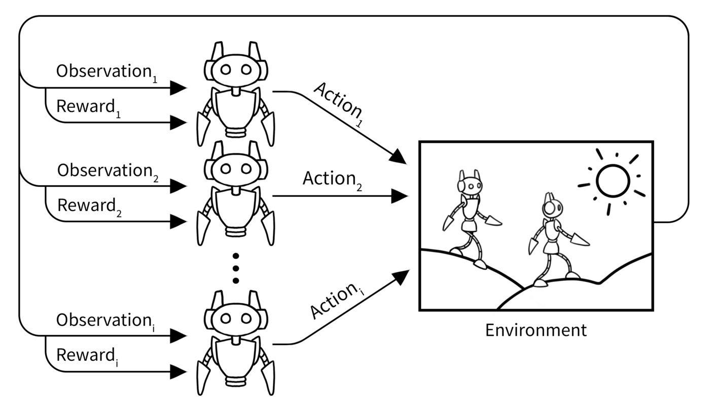
Environment- classification
Single agent
Multiple agent
In a single agent environment, there is only one agent that exists and interacts with the environment.
In a multi-agent environment, there are more than one agents that are interacting with the environment.

Slide 14
Environment- classification
episodic
sequential
In an episodic environment, the agent’s actions are confined to the particular episode only and not on any previous actions.
In a sequential environment, the agent’s actions are connected with the previous actions it took.

Slide 15
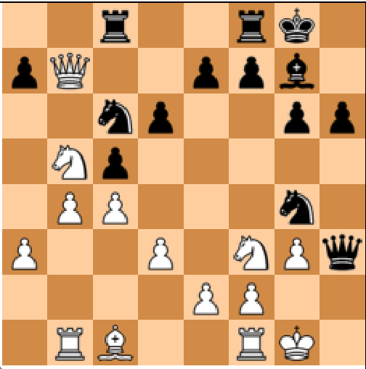
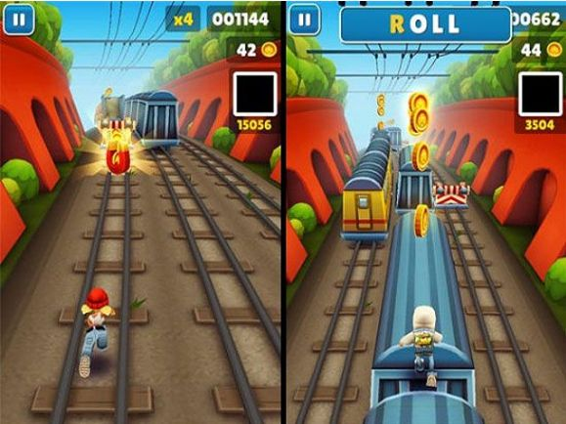
Environment- classification
Fully observable
Partially observable
In a fully observable environment, the agent is always aware of the complete state of the environment at any given point in time.
In a partially observable environment, the agent cannot always see the complete state of the environment at any given point in time.

Slide 16
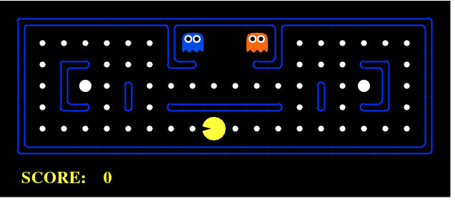
What type of environment is this?
Discrete
Stochastic
Single agent
Sequential
Fully observable

